Slide 1
CARDIAC MRI- Basics and role in coronary artery disease
Dr. sanmath Shetty
Senior resident
Medical college, Kozhikode.

Slide 2
Introduction
Magnetic Resonance (MR) : phenomenon involving magnetic fields and electromagnetic waves on the Radio Frequency (RF) domain.
Discovered in 1946 by 2 independent groups of investigators at Stanford (directed by Bloch) and at Harvard (directed by Purcell).
Uses different types of nuclei (1H, 13C, 19F, 23Na, 31P), however 1H is generally utilized for creating MR images.

Slide 3
MR Imaging system
3 main electromagnetic components:
A set of main magnet coils
3 gradient coils and
A radiofrequency transmitter coil.
Each generate a different type of magnetic field.

Slide 4
Main magnet:
  Generates a strong, constant magnetic field Bo.
  Reference coordinate system of 3 orthogonal axes x, y and z used to define the magnetic field.
  Z axis chosen to be parallel to direction of Bo.
Gradient coils:
  Generates gradient magnetic field in the same direction as Bo.
  Gradient field is superimposed onto the Bo magnetic field so that its strength increases (or decreases) along the direction of the applied gradient field.
Rf transmitter coils:
  Much smaller amplitude compared to other fields.
  Rf field referred to as B1.

Slide 5
Imaging Planes
Body planes and Cardiac planes.

Slide 6
Origin of MR signal
Primary origin of the MR signal used to generate images is from the hydrogen nuclei (consisting of a single proton) contained within free water or lipid molecules.
Hydrogen nuclei possess an intrinsic property known as quantum spin that gives rise to a small magnetic field known as a magnetic moment (µ).
The values taken by the spin, I, depend on the number of protons and neutrons inside the nucleus.
1H has a single proton and its spin is I = 1/2.
Notes:
Nuclei with unpaired protons and neutrons( i.e odd no of neutrons and protons are MR active.

Slide 7
The angular momentum, p, given by the spin I is:
p = h I
where h is Planck’s constant; p and I are vectors.
The so-called gyromagnetic ratio links the magnetic momentum m to the
angular momentum p
ɣ=µ/p
The value is a constant characteristic of the type of nucleus; ɣ for 1H= 42.57 MHz/T.

Slide 8
Normally the magnetic moments (spins) are randomly oriented.
In the presence of the externally applied Bo field, they tend to align either toward or against the externally applied magnetic field.
An equilibrium state is quickly attained where there is a small excess of spins aligned with the field as this is the more energetically favourable direction of alignment.
The excess of proton magnetic moments combines to form a net magnetic field or net magnetisation.
It is aligned along the positive z axis (along Bo) – Mo.

Slide 9
Precession
In the presence of Bo field, the protons do not simply line up but precess or ‘wobble’ around the Bo axis.
Analogous to spinning top, spins around its axis + precessing around its surface point of contact.
Larmor Equation ωo=ɣ×Bo
Larmor frequency proportional to the strength of the magnetic field.
42.57 X 1.5 = 63.8 Hz for 1.5T
Also known as the resonant frequency, as the protons only absorb energy (or resonate) at this characteristic frequency.

Slide 10
Resonance
RF energy is transmitted as an electromagnetic wave.
Its magnetic component B1 can interact with the magnetic moments of spinning protons.
RF pulse is perpendicular to Bo (z axis) in the x-y plane.
Unlike Bo, B1 field oscillates ---- responsible for resonance.
Only occurs if frequency of RF field equals precessional frequency of hydrogen nucleus at given field strength.
The protons align with the B1 field and start precessing around the axis of B1.
As a result, Mo now possesses coherent x-y magnetization.

Slide 11
Radiofrequency pulses
Before the rf pulse is switched on the net magnetisation,
Mo is aligned along the z-axis in the same direction as Bo.
Rf pulse is applied, Mo makes an angle with the z-axis, known as the flip angle, and rotates around the axis.
At any instant the magnetisation can be split into two components, Mz and Mxy.
The rotating Mxy component generates the detectable MR signal.

Slide 12
Maximum detectable signal amplitude after a single rf pulse occurs when Mo lies entirely in the plane of the x and y axes as this gives the largest Mxy component. This pulse is referred to as a 90° rf pulse or saturation pulse.
A 180° inversion pulse is usually applied at equilibrium and is used to rotate the net magnetisation through 180° from the positive to the negative z axis. This is also know as a magnetisation preparation pulse or inversion pulse. Used in inversion recovery and dark blood pulse sequences.

Slide 13
Relaxation
Immediately after the rf pulse, the spin system starts to return back to its original state - process known as relaxation.
Two distinct relaxation processes that relate to the two components of the Net Magnetisation, the longitudinal (z) and transverse(xy) components.
Longitudinal relaxation, referred to as T1 relaxation is responsible for the recovery of the z component along the longitudinal (z) axis to its original value at equilibrium.
Transverse relaxation, is responsible for the decay of the xy component as it rotates about the z axis, causing a corresponding decay of the observed MR signal.
Longitudinal and transverse relaxation both occur at the same time.
Transverse relaxation is a much faster process than longitudinal relaxation .

Slide 14
T1 relaxation
Due to spin lattice interactions.
T1 relaxation is an exponential process with a time constant T1.
T1: time at which the magnetization has recovered to 63% of its value at equilibrium
The shorter the T1 time constant is, the faster the relaxation process and the return to equilibrium.
Referred to as Saturation recovery.

Slide 15
Significance of T1 value
T1 relaxation- related to the rate of molecular motion, known as the tumbling rate of the particular molecule.
As molecules tumble, they give rise to a fluctuating magnetic field which is experienced by protons in adjacent molecules.
When this fluctuating magnetic field is close to the Larmor frequency, energy exchange is more favourable.
Eg: lipid molecules are of a size that gives rise to a tumbling rate which is close to the Larmor frequency. Fat has one of the fastest relaxation rates of all body tissues and therefore the shortest T1 relaxation time.
Free water- faster molecular tumbling rate- long T1 relaxation time.
Water molecules that are adjacent to large macromolecules- tumbling rate slowed down towards Larmor frequency-faster T1 relaxation. Eg: inflammation in muscle.
Notes:
Larger molecules have much slower
tumbling rates that are unfavourable for energy
exchange, giving rise to long relaxation times. For free
water, its smaller molecular size has a much faster molecular
tumbling rate which is also unfavourable for
energy exchange and therefore it has a long T1 relaxation
time.

Slide 16
T2 relaxation
Net magnetisation is the result of the sum of the magnetic moments (spins) of a whole population of protons.
During rf pulse- spins have similar phase angles ‘ in phase’.
Over time, there is loss of coherence and phase angles spread ‘ out of phase’
Transverse relaxation is the decay of transverse magnetization because of loss of coherence (dephasing) of spins.
The presence of interactions between neighbouring protons causes a loss of phase coherence known as T2 relaxation.
Has an exponential form with a time constant, T2.
T2 : the time necessary to reduce magnetization of the transverse component Mxy by 63%.
Notes:
Spin-spin interaction. T2 relaxation is irreversible.

Slide 17
T2* relaxation
Second cause for the loss of coherence (de-phasing) relates to local static variations (inhomogeneities) in the applied magnetic field, Bo.
Most of the inhomogeneities occur at tissue borders, particularly at air/tissue interfaces.
Protons at different spatial locations will therefore rotate at different rates ---- further de-phasing so that the signal decays more rapidly.
The combined effect of T2 relaxation and the effect of magnetic field non-uniformities is referred to as T2* relaxation.
Determines the actual rate of decay – Free induction decay (FID).

Slide 19
Significance of T2 value
T2 relaxation is related to the amount of spin-spin interaction.
Free water contains small molecules that are relatively far apart - spin-spin interactions are less frequent and T2 relaxation is slow (long T2 relaxation times).
Tissues with a high macromolecular content (e.g. muscle) tend to have shorter T2 values.
When the water content is increased by an inflammatory process, the T2 value also increases.
Notes:
Water molecules bound to large molecules
are slowed down and more likely in interact, leading
to faster T2 relaxation and shorter T2 relaxation
times.

Slide 20
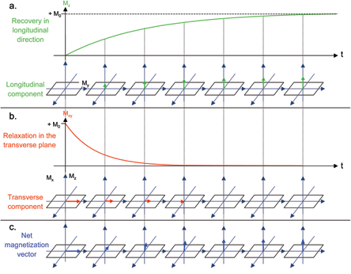

Slide 21
Inversion recovery(IR)
Most commonly used form of magnetization preparation.
Depends on the fact that different tissues have different T1 characteristics.
An 180º RF pulse (or inversion pulse) is used to flip the magnetization into the opposite direction along the z-axis.
From this position, the magnetization relaxes back to its original state.
The longitudinal magnetization of different tissues will pass through zero (i.e. the magnetization will be completely in the x–y plane) at different times.
During RF excitation (which is applied some time after the IR pulse) only tissues with non-zero longitudinal magnetization will produce an MR signal.
If the time between inversion and imaging (TI) is chosen carefully, signal from a given tissue can be completely abolished.

Slide 22
MR echoes
For MR imaging it is more common to generate and measure the MR signal in the form of an echo.
Two most common types of echo used for MR imaging :
  Gradient echoes
  Spin echoes.

Slide 23
Gradient echo
Notes:
The application of the 1st positive magnetic field gradient causes rapid de-phasing of the transverse magnetisation,
Mxy, and therefore the FID signal to zero amplitude. The application
of the 2nd negative magnetic field gradient reverses the de-phasing
caused by the first gradient pulse, resulting in recovery of the FID signal to generate a gradient echo at the echo time, TE. Extension
of the time duration of the second gradient to twice that of the first gradient causes the FID to then de-phase to zero.

Slide 24
Spin echo
Notes:
The presence of magnetic field inhomogeneities causes additional de-phasing of the proton magnetic
moments. After a period of half the echo time, TE/2, the application of a 180° rf pulse causes an instantaneous change in
sign of the phase shifts by rotating the spins . As the differences in Larmor frequency remain unchanged, the
proton magnetic moments then move back into phase over a similar time period, reversing the de-phasing effect of the magnetic field
inhomogeneities to generate a spin echo.

Slide 25
Spin echo versus gradient echo
180° refocusing pulse removes the de-phasing caused by magnetic field inhomogeneities, the amplitude of the spin echo signal is greater than the gradient echo signal.
Imaging based on spin echo is also less affected by the presence of field inhomogeneities caused by metallic artefacts (e.g. sternal wires or metallic heart).
Gradient echo imaging more affected by the presence of magnetic field inhomogeneities caused by iron, more useful in the assessment of patients with increased iron deposition within the heart.

Slide 26
Time of Repetition (TR) and Echo time (TE)
Time of repetition: In a sequence of pulses the Time of Repetition (TR) is the time lapsing between two RF pulses.
The Time of Echo or echo time (TE): is the time between the RF excitation pulse and the center of the echo, that is where the signal has acquired its maximum intensity.

Slide 27
IMAGE CONTRAST
3 intrinsic features of a biological tissue contribute to its signal intensity or brightness on an MR image and hence image contrast:
Proton density -the no. of excitable spins per unit volume- determines the max. signal that can be obtained from a given tissue.
T1 relaxation time of tissue
T2 relaxation time of tissue
The TR and TE are chosen to weight the image contrast so that it is either primarily dependent upon the differences in T1 relaxation times (T1-weighted), or primarily dependent on the differences in T2 relaxation times (T2 weighted).
If the parameters are chosen so that the image contrast is influenced by neither the T1 or T2 differences, the tissue signal is said to be primarily ‘proton density’ weighted.

Slide 28
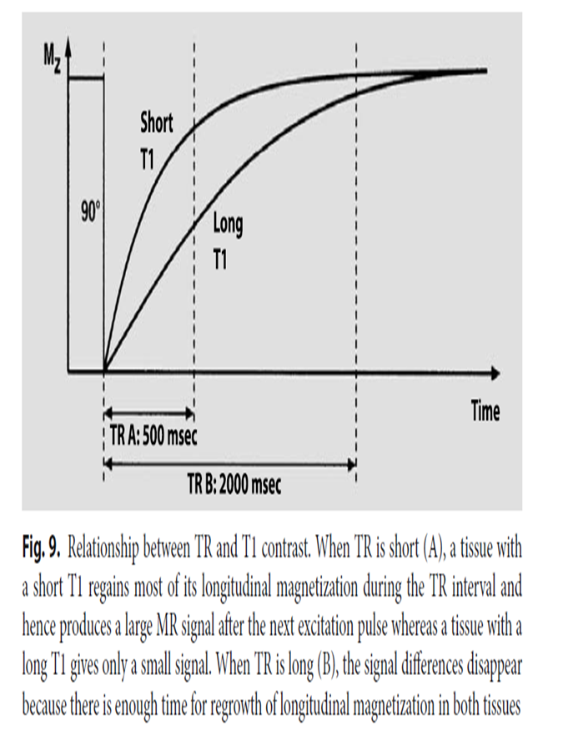
The TR controls the T1 weighting
Short TR → strong T1 weighting.
Long TR → low T1 weighting.
Tissues with a short T1 appear bright.
Tissues with a long T1 appear dark.
Notes:
because they regain most of their longitudinal magnetization during the TR interval and thus produce a stronger MR signal

Slide 29
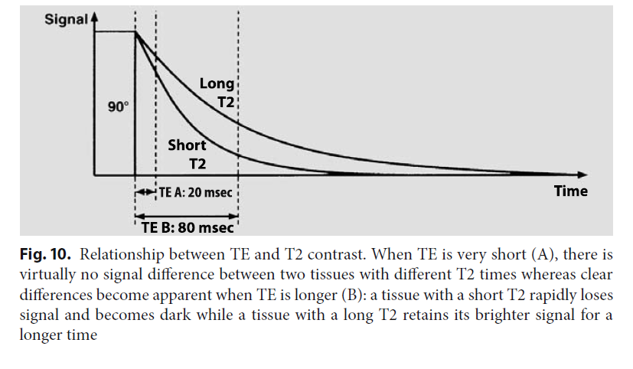
TE controls the T2 weighting
Short TE → low T2 weighting.
Long TE → strong T2 weighting.
Short T2 → dark on T2-weighted images.
Long T2 → bright on T2-weighted images

Slide 30
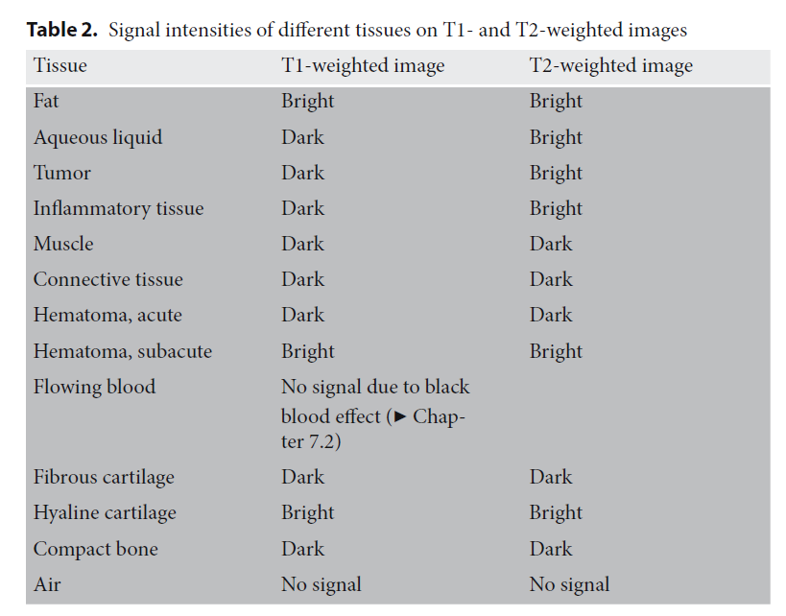

Slide 31
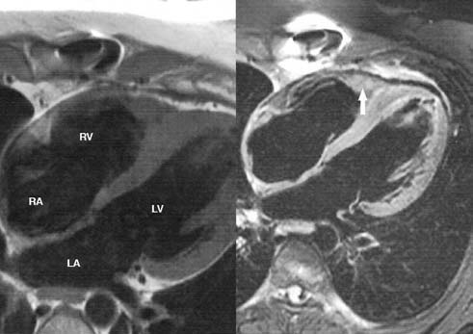
T1 weighted vs T2 weighted image

Slide 32
CMR TERMINOLOGY | DEFINITION | COMMON TERMS
Black blood imaging | Produces bright signals for muscle but a signal void from moving blood | Spin echo, fast spin echo
Bright blood imaging | Produces bright signal for blood and darker signal for myocardium. Use in cine images | Fast field echo (FFE) Gradient recalled acquisition in steady state (GRASS)
Steady state free precession | Signal produced by rapidly applying balanced gradients and RF pulses. | Balanced FFE FIESTA(fast imaging employing steady state acquisition)

Slide 33
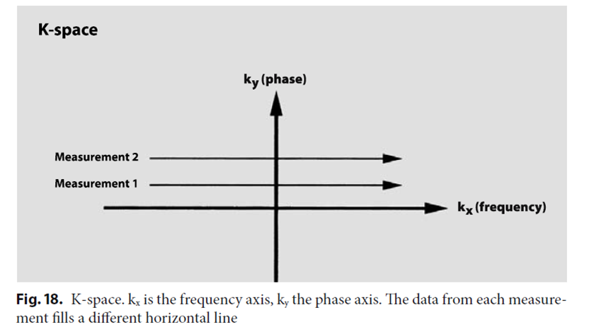
The K- Space
It is a graphic matrix of digitized MR data that represents the MR image before Fourier transformation is performed.
Each line in k-space corresponds to one measurement and a line is acquired for each phase-encoding step.

Slide 34
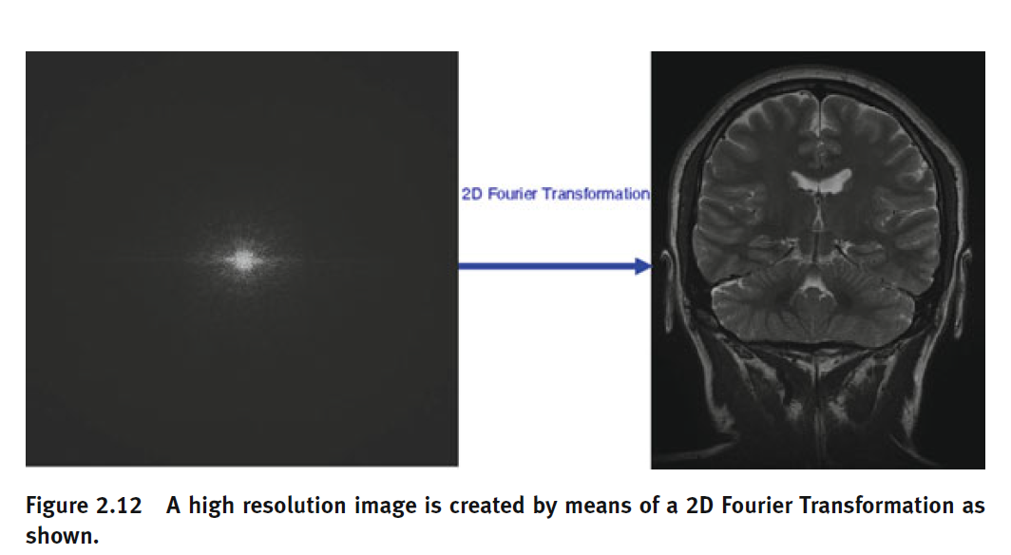
Fourier Transform
Transforming the frequency-encoded raw MR data recorded at the system can be done with Fourier Transformation.
Fourier Transformation is a mathematical model transforming the frequency-encoded data from k-space to MR image domain.

Slide 35
Synchronising with the cardiac cycle
To capture an image of the heart that is unaffected by motion requires an image to be acquired in just a few tens of milliseconds.
Limits the number of phase encoding steps (and thus the spatial resolution).
To achieve acceptable image quality, the image acquisition time becomes too long to ‘freeze’ heart motion.
For routine CMR therefore, the MR signals are acquired over multiple heart beats, synchronising the pulse sequence and therefore the signal acquisition to a particular time point in the cardiac cycle using patient’s ECG.
For static imaging, imaged during diastasis, when the myocardium is most at rest (mid to distal diastole).
Weissler- Stuber formula: trigger delay(ms) = [(RR interval(ms) – 350) x 0.3] + 350
2 ways of cardiac synchronization for cine imaging:
  Prospective – ECG trigerring
  Retrospective- ECG gating.

Slide 36
Notes:
ECG triggering initiates the data acquisition of the first cardiac phase immediately after the R-wave and acquires a predetermined number
of cardiac phases. The data acquisition must stop before the end of the cardiac cycle to allow detection of the next R-wave. This results in the
last part of the cardiac cycle not being imaged. Retrospective ECG gating acquires data continuously and records the temporal position
of the acquired data relative to the R-wave. The acquisition continues until k-space is filled for a sufficient number of time points and the data is
sorted into cardiac phases retrospectively. This approach allows data to be assigned accurately to the end of the cardiac cycle, ensuring the
whole of the cardiac cycle is imaged.

Slide 37
Dealing with respiratory motion
3 possible approaches:
  Respiratory compensation methods (respiratory gating).
  Cardiac synchronised fast imaging techniques combined with patient breath-holding.
  Ultra-fast (single-shot) imaging techniques.
In practice, most cardiac imaging is performed with patient breath-holding combined with fast imaging techniques.

Slide 38
Safety issues
Implants hazardous in CMR imaging
  Cochlear implants
  Neurostimulators
  Hydrocephalus shunts
  Metal containing ocular implants
  Pacing wires
  Metallic cerebral aneurysm clips
Sternal wires, mechanical heart valves, annuloplasty rings, coronary stents, orthopedic or dental implants- safe.

Slide 39
Magnetic resonance imaging in patients with implanted cardiac devices
Potential adverse effects of MRI on implanted cardiac devices include:
  radiofrequency-induced heating of the lead tips
  pacing inhibition/dysfunction
  asynchronous pacing with the possibility of induction of atrial or ventricular tachyarrhythmias
  transient reed switch activation
  change or loss of programmed data and changes in capture threshold.
Closer the scanning area is to the system, the higher is the risk.

Slide 40
Notes:
Exclude patients with leads that have not matured (6 weeks since implantation, during which the leads are
prone to spontaneous dislodgement) and those with epicardial and abandoned leads (which are prone to
heating).
Programme an asynchronous pacing mode in PM-dependent patients to avoid inappropriate inhibition of pacing due to detection
of electromagnetic interference.
Use an inhibited pacing mode for patients without PM dependence, to avoid inappropriate pacing due to tracking
of electromagnetic interference.
Deactivate other pacing functions (magnet, rate, noise, PVC, ventricular sense, AF response) in order to ensure that
sensing of electromagnetic interference does not lead to unwarranted
pacing.

Slide 41
Contrast agents
Currently only GBCAs (Gadolium based contrast agents) used in clinical practice.
After iv bolus, GBCA takes 15 to 30 seconds for trasit through cardiac chambers and blood vessels (first pass).
Later it diffuses into extracellular space. At approx. 10-15 minutes a transient equilibrium between contrast washing-in into extracellular space and washing- out into blood pool is reached (equilibrium phase).
Myocardial perfusion CMR and MR angiography- first pass phase.
Late Gadolinium enhancement(LGE) images- equilibrium phase.
GBCAs are chelated to make them nontoxic and to allow renal elimination by glomerular filtration.
Extracellular contrast media are administered intravenously as a bolus or drip infusion at a dose of 0.1–0.3 mmol/kg body weight

Slide 42
Adverse effects
Headache, nausea, or mild allergic reactions of the skin and mucosa occur in 1% of cases.
Extravasated contrast medium can cause local pain and inflammatory reactions including tissue necrosis.
Anaphylactic shock induced by an MR contrast agent is extremely rare (about 1:50,000 cases).
Nephrogenic systemic fibrosis.

Slide 43
Nephrogenic systemic fibrosis
Characterised by increased tissue deposition of collagen.
Interstitial inflammatory reaction – leads to severe skin induration, contracture of extremities, fibrosis of internal organs and even death.
Risk factors:
  High dose GBCA regimens(>0.1 mmol/kg) with estimated GFR <30 ml/min/1.73m2.
  Need for hemodialysis.
  eGFR < 15 ml/min/1.73m2.
  Use of gadodiamine.
  Acute renal failure
Previous incidence 0.02%. Now, a near zero incidence is reported.

Slide 44
Assessment of CAD
Role of imaging in CAD:
Visualization of CAD
Evaluation of consequences of CAD on heart, i.e, impact of myocardial perfusion and function.
Depiction of reversible/ irreversible myocardial damage.
Cardiac MRI could not fulfill its promises to reliably image coronaries (role currently claimed by CT).
Preferred imaging modality to study the ischemic consequences of CAD on myocardial perfusion, function and myocardial integrity.

Slide 45
Functional Imaging
A direct consequence of IHD is a temporary or permanent impairment of myocardial contractility.
Cine MRI: non invasive , accurate tool
  visualize regional wall motion and contraction patterns
  calculate ventricular volumes and function
  study long-term effects such as ventricular remodelling
Functional impairment can be expressed qualitatively, e.g., hypokinetic, akinetic or dyskinetic wall motion, or quantitatively using the relative or absolute wall thickening.

Slide 47
Horizontal long axis cine imaging at 1 week (a), 4 months (b), 1 year (c), and 5 years (d) after the acute event.
Cine imaging allows to appreciate the infarct healing with thinning of the LV apex, and the progressive LV dilatation over time (a–d).
Use of MRI for longterm follow-up of ventricular remodeling post-myocardial infarction

Slide 48
Myocardial perfusion
In normal conditions, there is a balance between myocardial oxygen demand and oxygen supply.
Changes in oxygen demand result in proportional variations of myocardial blood flow.
In resting conditions, the myocardial perfusion is not altered until the coronary artery has a 85–90% stenosis- result of the coronary vasodilator reserve.
Most frequently used approach to assess myocardial perfusion imaging (MPI) with MRI (MR-MPI) is monitoring of the first-pass of contrast medium through the heart, using a bolus injection of MR contrast media in combination with fast MR sequences.
Most utilized sequences are the fast and ultrafast Gradient Echo, FLASH or turbo-FLASH and Echo-planar derived sequences (EPI).

Slide 49
Perfusion defect
Onset of a myocardial perfusion defect coincides with the start of myocardial enhancement.
Most pronounced in the subendocardium and the transmural extent is variable.
The duration of the defect ranges from brief to prolonged (persistent till the second pass), while it resolves from the edge to the center of the perfusion defect, thus from subepi- to subendo-cardium.
The defect obeys anatomic borders as well as the boundaries of the CA perfusion territories.
Microvascular disease presents as circular perfusion defect not respecting perfusion territories, difficult to differentiate from artefacts.
Perfusion defects, caused by hemodynamically significant stenoses, are usually only visible during stress perfusion imaging.

Slide 50
Dark rim artefacts
They typically occur at the interface between blood-pool and myocardium.
Due to Gibbs phenomenon.
Appear as soon as the contrast arrives in the LV cavity.
More likely to occur with a higher contrast dose , balanced SSFP sequence.
Occur on the basal half of the left ventricle, along the septal border and around the papillary muscles.
Darker than a true perfusion defect.
Dark rim artefacts do not obey CA perfusion territories.
Notes:
PECULIAR MANNER IN WHICH THE FOURIER SERIES OF A CONTINUOUSLY DIFFERENTIABLE PERIODIC FUNCTION BEHAVES AT A JUMP DISCONTINUITY.IN MRI, GIBBS PHENOMENON CAUSES ARTEFACTS IN PRESENCE OF ADJACENT REGIONS WITH MARKED DIFFERENT SIGNAL INTENSITIES.

Slide 51
Late Gadolinium Enhancement (LGE)
Concept: based on delayed wash in and wash out in tissue with increased proportion of extracellular space.
Gd molecular size allows it to distribute in extracellular space without entering myocardial cells in normal conditions.
Acute MI – cellular necrosis and edema.
Chronic infarct- fibrous scar tissue.
Demonstrated by T1 weighted imaging.
Contrast to noise ratio improved with introduction of inversion recovery principle (nulls signal from normal myocardium).
10-30 mins after contrast administration.

Slide 52
Both acute and chronic scars from MI show LGE.
Differentiate based on wall thinning and T2 weighted imaging:
Acute scars: high intensity on T2 due to edema, no wall thinning.
Chronic scars: wall thinning.

Slide 53
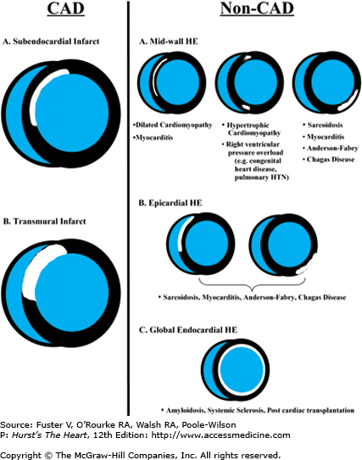
Hyperenhancement patterns
Notes:
In ischemic necrosis, the progression of a hyperintense area proceeds
from the subendocardium to the subepicardium. This particular location and progression
of late hyperintensity is specific for postischemic myocardial fibrosis
and differs from the other forms of myocardial fibrosis, such as marked
hypertrophy, myocarditis, and non-ischemic dilatative cardiomyopathy in
which late hyperintensity, if present, is distributed in a disorganized fashion
inside the myocardium.

Slide 54
Stress MRI
The coronary artery system is anatomically divided into two districts: large conductive epicardial arteries and resistance arterioles.
Arterial vasodilation compensates the increase of resistances occurring at the level of the epicardial coronaries.
In the absence of stenosis, coronary vasodilatatory reserve increase the coronary flow (up to fourfold the basal value) in response to metabolic needs.
In the presence of stenosis, the vasodilatatory reserve is used to keep coronary flow constant at basal conditions.
When the stenosis is subocclusive (over 90%) the vasodilatatory reserve is unable to keep the flow constant even at basal conditions.

Slide 55
Notes:
Metabolic alterations are the first to ensue to the reduction in coronary flow.
Alterations of the diastolic function (altered relaxation) then set in, followed by
alterations of the systolic function (reduction of regional contractility).
Subsequently, electrocardiographic changes occur, which ultimately announce
the manifestation of precordial pain

Slide 56
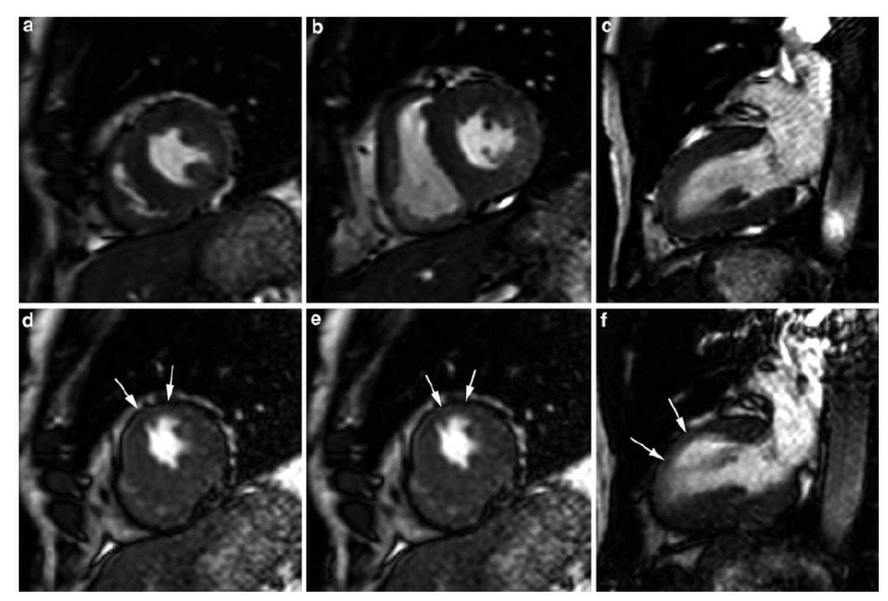
Pharmacologic protocol
Dobutamine: sympathomimetic, t1/2: 2 mins, acts on b1 receptors, less on a1 and b2 receptors.
Induction of ischemia: increase o2 consumption by positive inotropic and chronotropic effect.
AT EACH STRESS LEVEL
3 CINE SHORT AXIS
3 CINE LONG AXIS
OF LV ACQUIRED

Slide 59
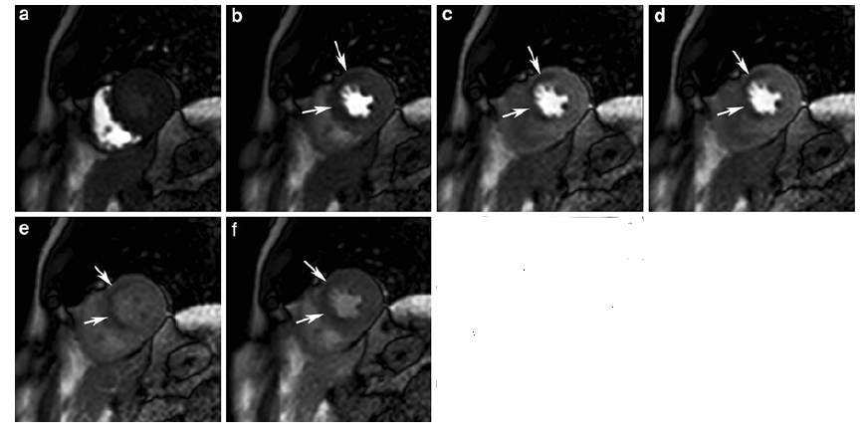
Vasodilator agents/ Stress perfusion CMR
Dipyridamole: indirect vasodilator through its inhibition of adenosine reuptake.
Adenosine: nonselective vasodilator that activates adenosine A1 receptors. Activates adenosine A3 receptors, causes bronchospasm and mast cell degranulation.
Regadenoson: newly approved vasodilator that selectively activates the adenosine 2A receptors present primarily in the coronary circulation.
Stress and rest perfusion imaging acquisitions are separated by a delay to allow for the washout of GBCA.
Images with GBCA injected with a power injector at a rate of 3 to 7 mL/s.
Total GBCA dose is divided in 2, with half administered during stress and half administered at rest.
Either the stress or rest perfusion can be performed initially.
If the pharmacologic stress perfusion is performed first, the delay also allows for the effects of the vasodilator to wear off.

Slide 60
Risk stratification
Severity of contractile dysfunction
Extension of ischemic area
Time to ischemia
Reversibility of ischemia

Slide 61
Appropriate use criteria ACC/AHA 2006

Slide 62
Edema Imaging
Increased free water in the infarcted myocardium prolongs T1- and T2-relaxation.
Differences in T1-relaxation have shown not to be clinically useful for infarct detection unless paramagnetic contrast agents are administered.
T2-relaxation time is linearly correlated to the percentage of free water and infarcted myocardium is visible on T2-weighted MR sequences (T2w-imaging) as areas of increased signal intensity.
In the setting of acute ischemia, the amount of free water may increase not only in the irreversible but also in the reversible injured myocardium- overestimation of the true extent of myocardial necrosis.
  Related to reversible cell swelling, increased capillary permeability in the surrounding ischemic rim and occurrence of myocardial edema.
Currently, it is accepted that the hyperintense myocardium on T2w-imaging reflects the myocardium at risk, i.e. the myocardium that is ischemically jeopardized and at risk to become necrotic

Slide 63
Myocardial viability
Damage caused by long-term reduced myocardial perfusion can manifest through changes in metabolism and functional condition of the myocardium.
Stunned myocardium: a metabolic change causes an unbalance between the function and the energetic supply causing a contractile dysfunction, despite the presence of a normal myocardial blood flow (mismatch function-flow). Functional recovery often appears spontaneously days or months after the ischemic event.
Hibernating myocardium: contractile dysfunction is associated to a chronic reduction of myocardial flow (match function/flow). Functional recovery occurs only after the re-establishment of normal conditions of myocardial flow.

Slide 64
Evaluation of myocardial viability with MRI techniques (chronic IHD)
End-diastolic wall thickness: criterion of myocardial necrosis has been identified in a diastolic thickness <5.5 mm.
Contractile reserve: Typical approach is to use low dosages of dobutamine (5-10 μg/kg/min up to 5 min) to induce the improvement of regional function in those segments with baseline impaired contractility(systolic wall thickening >2mm).
  Sensitivity and specificity of dobutamine MRI for the diagnosis of myocardial viability is 74 and 83% respectively.
Delayed enhancement with contrast:
Sequence used: Inversion Recovery Gradient Echo (IR-GRE). Acquisition is performed in diastole.
Viable myocardium: hypointense; necrotic myocardium: strongly hyperintense.

Slide 65
Viability in Acute MI
Combining first pass perfusion with delayed enhancement:
3 patterns in patients with acute MI who have been reperfused
  Signal hypointensity at first pass without late hyperintensity(hypo)
  Early and late hyperintensity (hyper)
  Early hypointensity and late hyperintensity(comb)
‘Hyper’ segments show better recovery of contractile function, hypo do not improve and comb show intermediate response.
No reflow phenomenon:
  Absence of an increase in signal in the layers at the center of the infarcted area in early phase surrounded by a hyperintense halo, in which there is a further increase of signal in the later phase.
  Associated with absence of contractile reserve and poor prognosis for functional recovery.
  Characterised by severe myocardial necrosis and microvascular damage.
Transmural extent of hyperenhancement- recovery highly probable in those with <25% extension; practically nil with > 75% extension.
Notes:
The time elapsed after the ischemic event is fundamental
as the same pattern of late hyperintensity identifies a partially viable tissue
in patients with acute myocardial infarction, and necrotic tissue in patients
with previous myocardial infarction

Slide 66
Time varying signal intensity changes following contrast administration in a patient with acute MI
Notes:
Normal myocardium is characterized by a rapid
wash-in and wash-out of contrast, while signal intensity
infarcted myocardium progressively increases. Microvascular
obstruction is characterized by lack of signal and slow decrease
in extent over time

Slide 67
Infarct related complications
Complications related to MI such as :
Aneurysm formation
  useful to depict and differentiate true from false ventricular aneurysms.
  Smaller orifice size and pericardial enhancement in false aneurysms
Thrombus formation
  best visualized early after contrast administration taking advantage of the high contrast of the blood pool.
  appear as hypo-intense filling-defects.
  thrombus enhancement on late imaging can be found in organized clots
Valve leakage
Associated pericardial effusion
Post-infarction pericarditis

Slide 68
MR angiography of coronaries
Diagnostic capacity of MR is based on the administration of a contrast agent and the acquisition of 3D images (CEMRA) during mid diastole(diastasis).
Visualization of the coronaries with this technique is difficult.
  small dimensions of the structure (less than 5 mm)
  the contorted and variable coursing
  the rotational and translational movement caused by cardiac and respiration activity.
“Black blood” techniques: completely cancel out signal from blood by double inversion pulse.
“White blood”techniques: several acquisition techniques (Gradient Echo, echo planar, spiral, etc.) that have the advantage of being faster with excellent contrast between vascular lumen and fat.

Slide 69
Feasibility of coronary MRA
Varies according to the coronary and to the arterial segments considered.
Higher for the Left Main (LM) and for the proximal segments of the LAD, RCA and CX as compared to the distal segments of these arteries and of the secondary branching.

Slide 71
Plaque characterisation by MRI.
Better validated in carotid arteries and aorta.
The lipid plaques have both a short T1 and a short T2 - hyperintense in T1-weighted images and hypointense in T2.
Fibrous plaques have a quite similar signal intensity in T1- and T2-weighted images; the signal intensity is lower compared to lipid plaques in T1-weighted images.

Slide 72
THANK YOU

Slide 73
MCQ 1
Larmor frequency of 1H at 1.5T and 3.0T?
A.) 63.8 and 127.7 Hz
B.) depends on manufacturer.
C.) 64.8 and 128.7 Hz
D.) 127.7 and 48 Hz
Notes:
A

Slide 74
MCQ 2
For coronary magnetic resonance (MR) angiography, data are typically obtained over several cardiac cycles. To freeze cardiac motion, it is desirable to obtain image data during a very short time period within each cycle. What would the optimal time for data collection be?
A. 75 ms after the QRS
B. Early systole
C. Early diastole
D. Mid diastole
Notes:
D
Coronary motion is typically minimal during diastasis that occurs after rapid
ventricular filling and before atrial filling, i.e., in mid diastole

Slide 75
MCQ 3
Given figure is a delayed-enhanced image in the 4-chamber orientation from a patient with old AWMI with heart failure. The dark rim at the endocardial surface of the apex is likely:
A. Myocardial salvage from timely reperfusion therapy
B. Suggestive of noncompaction cardiomyopathy
C. Mural thrombus
D. Incomplete myocardial signal suppression from incorrectly selected inversion time
Notes:
C

Slide 76
MCQ 4
In a patient with CAD undergoing CMR for evaluation of myocardial viability, delayed images are obtained after contrast is administered intravenously. This study demonstrates a dark endocardial rim adjacent to a bright transmural infarct zone. Which of the following would not be in the differential diagnosis of this finding?
A. Mural clot
B. Microvascular obstruction
C. Calcium deposition at the endocardial surface of the infarct territory
D. Preserved endocardial viability with only epicardial extension of the infarct
Notes:
D
It is not possible to have preserved (viable) subendocardium with infarcted epicardium.
Ischemia and infarction occur first at the subendocardial layers

Slide 77
MCQ 5
With dobutamine stress CMR, which of the following statements is correct?
A. The inotropic reserve at low-dose dobutamine is a measure of myocardial
ischemia
B. Baseline atrial fibrillation makes the study unreliable
C. Previous use of β-blockers does not interfere with the diagnostic accuracy
for assessment of ischemia
D. Diagnostic accuracy is superior to that of dobutamine echocardiography
Notes:
D
The inotropic reserve at low-dose
dobutamine is a measure of myocardial viability but not of ischemia. Baseline atrial
fibrillation makes the study difficult but not unreliable, because it affects mainly the
diastolic and not the systolic period

Slide 78
MCQ 6
Which of the following statements is correct regarding the usefulness of CMR coronary angiography?
A. It is indicated to assess for significant CAD
B. It is indicated for screening of subclinical atherosclerosis
C. It has high sensitivity but low–moderate specificity for detection of proximal
and mid-significant CAD in selected individuals
D. It is not useful for assessment of coronary anomalies
Notes:
C

Slide 79
MCQ 7
Dobutamine stress CMR compares favorably with dobutamine stress echocardiography for all the following reasons except for:
A. Ability to image obese patients and those with emphysema
B. Superior endocardial definition
C. Better patient monitoring
D. Highly reproducible imaging at the various levels of stress
Notes:
C
Patient monitoring is more difficult in thE CMR environment, and claustrophobia is an additional limitation

Slide 80
MCQ 8
Nuclei which are used for MR imaging include all except:
A.) H1
B.) Na23
C.) O16
D.) F19
Notes:
C

Slide 81
MCQ 9
When material is placed inside a strong magnetic field, the hydrogen
nuclei:
A. Align all their spins parallel to the direction of the main magnetic field
B. Align their spins either parallel or opposite to the direction of the main magnetic field
C. Start interacting with each other, resulting in T1 relaxation
D. Loose energy, resulting in T2 decay
Notes:
B

Slide 82
MCQ 10
Which of the following statements is correct regarding MRI of biologic
tissues?
A. T1 (longitudinal, spin-lattice relaxation) is shorter than T2 (transverse, spin spin relaxation)
B. Fluids have long T1 and T2 values
C. Fluids and fat both have long T1 values
D. T1 is equal to T2 for most tissues
Notes:
B
Biologic tissues have characteristic T1 and T2 values. T1 is longer than T2. Fluids
have long T1 and T2 values (mnemonic: long drinks). Fat tissue has short T1 and
T2 values (mnemonic: fast food)

Slide 83
MCQ 11
Current gadolinium chelates (e.g., Gd-DTPA) that are commonly used as
CMR contrast agents are:
A. Intracellular agents
B. Extracellular agents
C. 60% extracellular and 40% intracellular
D. Extracellular for the first 5 minutes after administration and then intracellular
Notes:
B

